Slide 1
Data Science Project - Analyzing 911 Calls
Prof. Moussa Doumbia
By:
Team TensorFlow

Slide 2
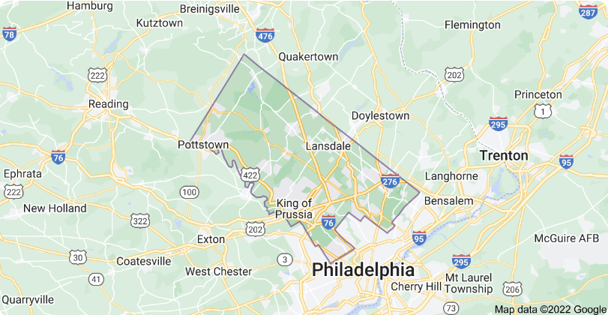
OverView
This Project is about analyzing the 911 calls (emergency calls), made during year Dec 2015 - June 2020 in the in Montgomery County, Pennsylvania. Montgomery County is a county in the Commonwealth of Pennsylvania, and is the third-most populous county in Pennsylvania and the 73rd-most populous county in the United States.

Slide 3
Let us first know about 911 calls a bit !
911 calls are saving 25000 lives each year and property of worth over $55 million each year.
Data shows that each year 240 million 911 calls are made in USA.
What are 911 calls??

Slide 4
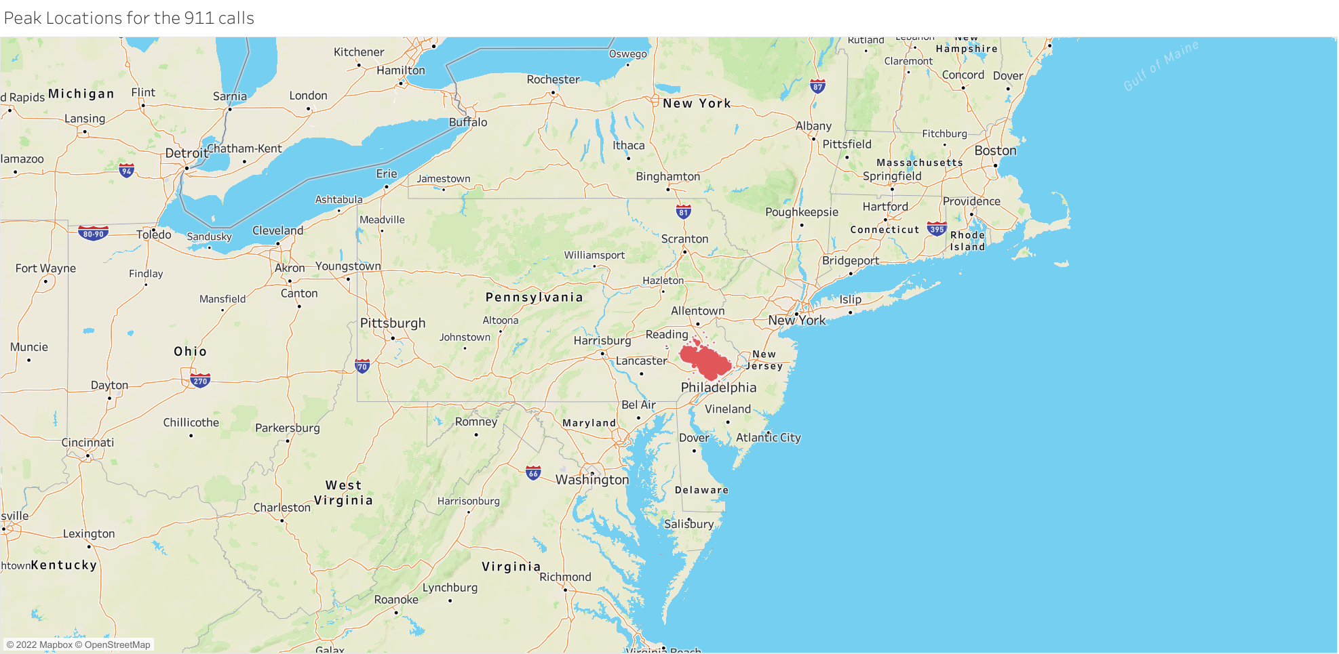
The Regions/Areas that we will be dealing with

Slide 5
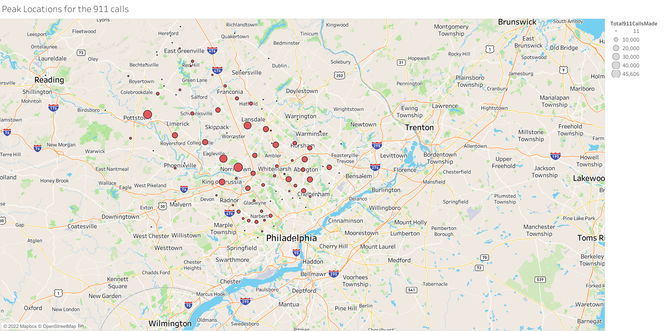
Areas with Highest calls made

Slide 6
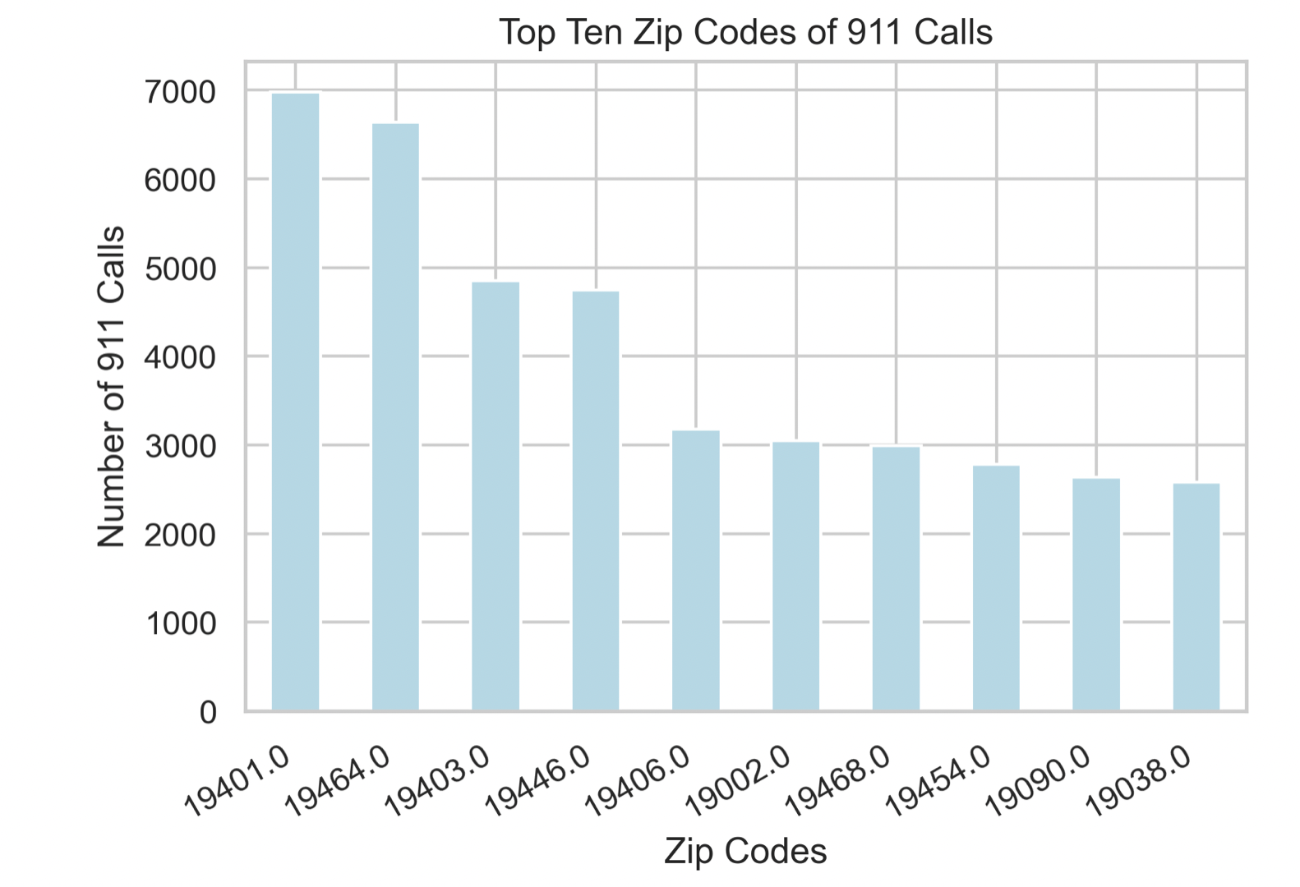
Top 10 Zip Codes of 911 Calls

Slide 7
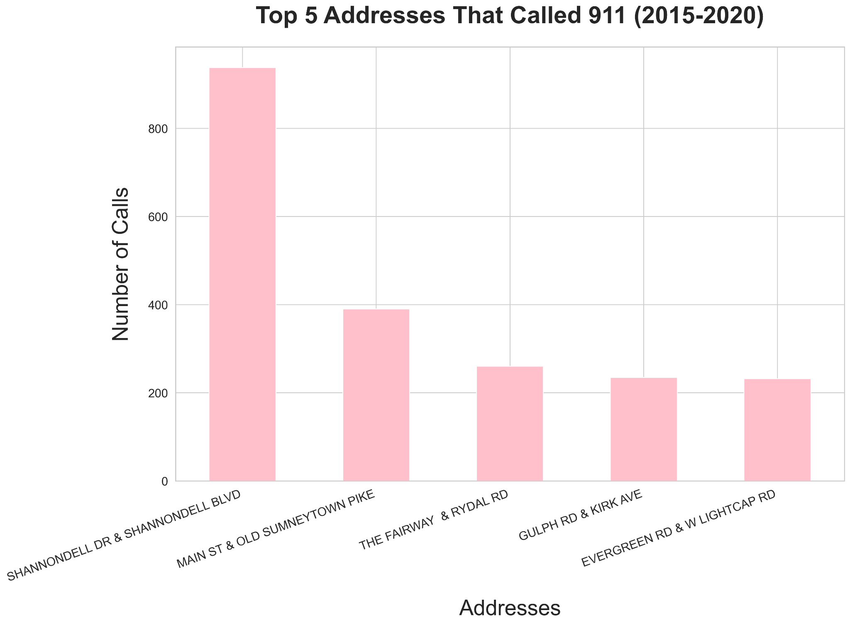
Top 5 Address that called 911

Slide 8
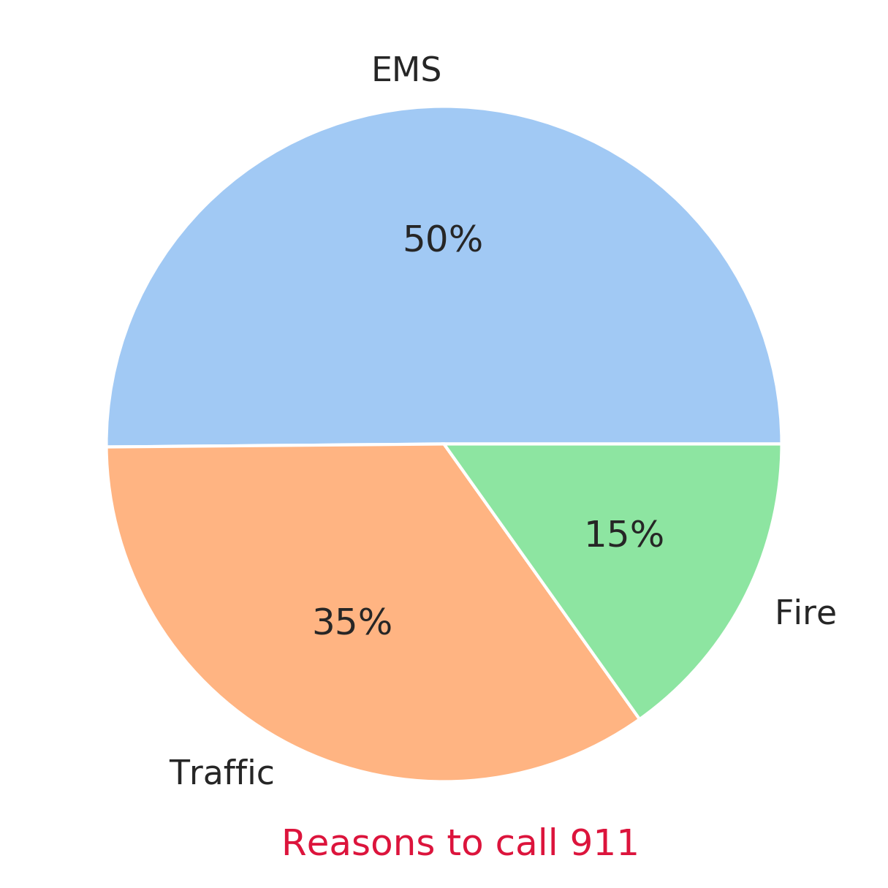
Why are calls being made?

Slide 9
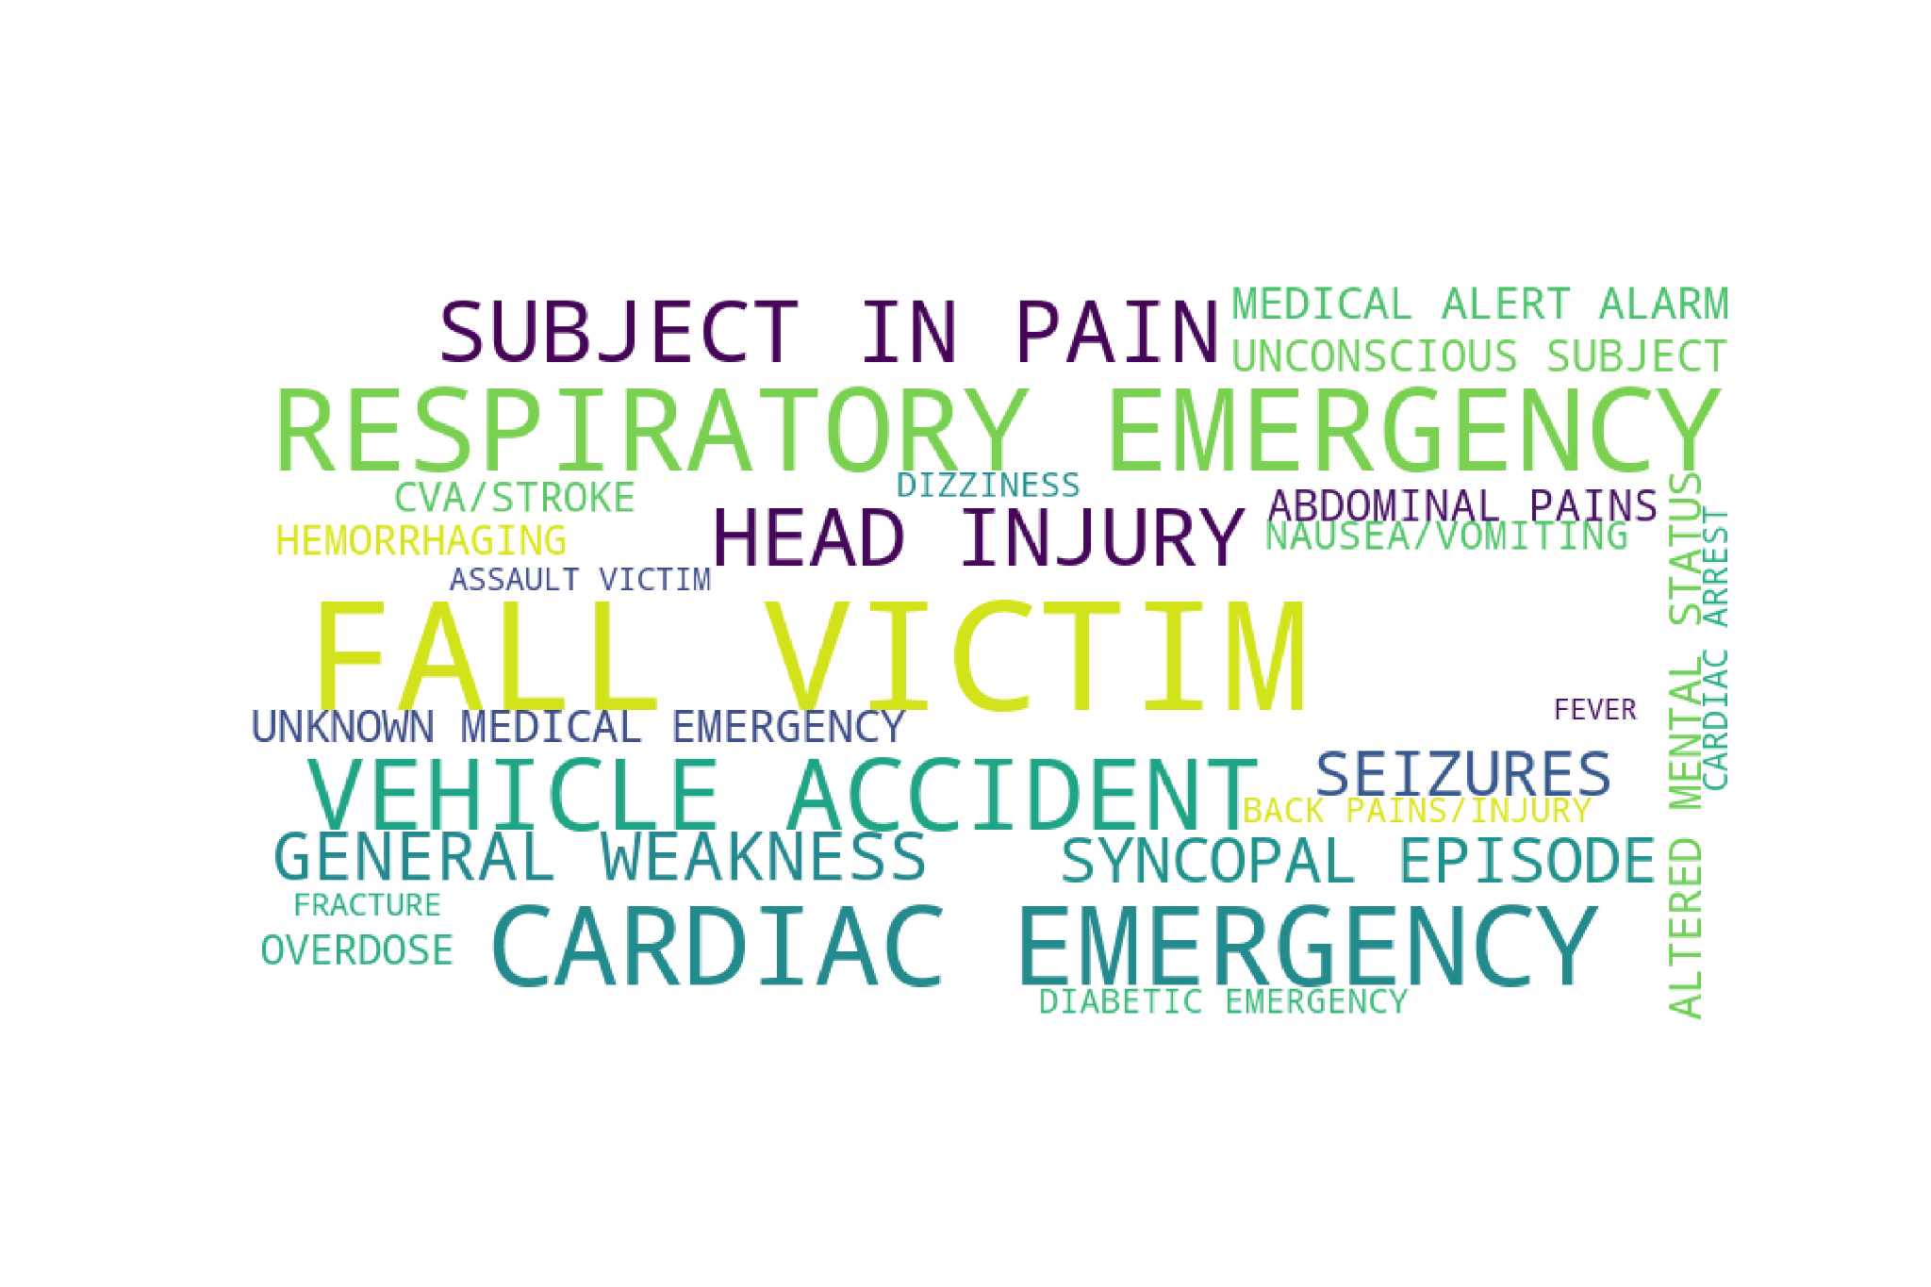
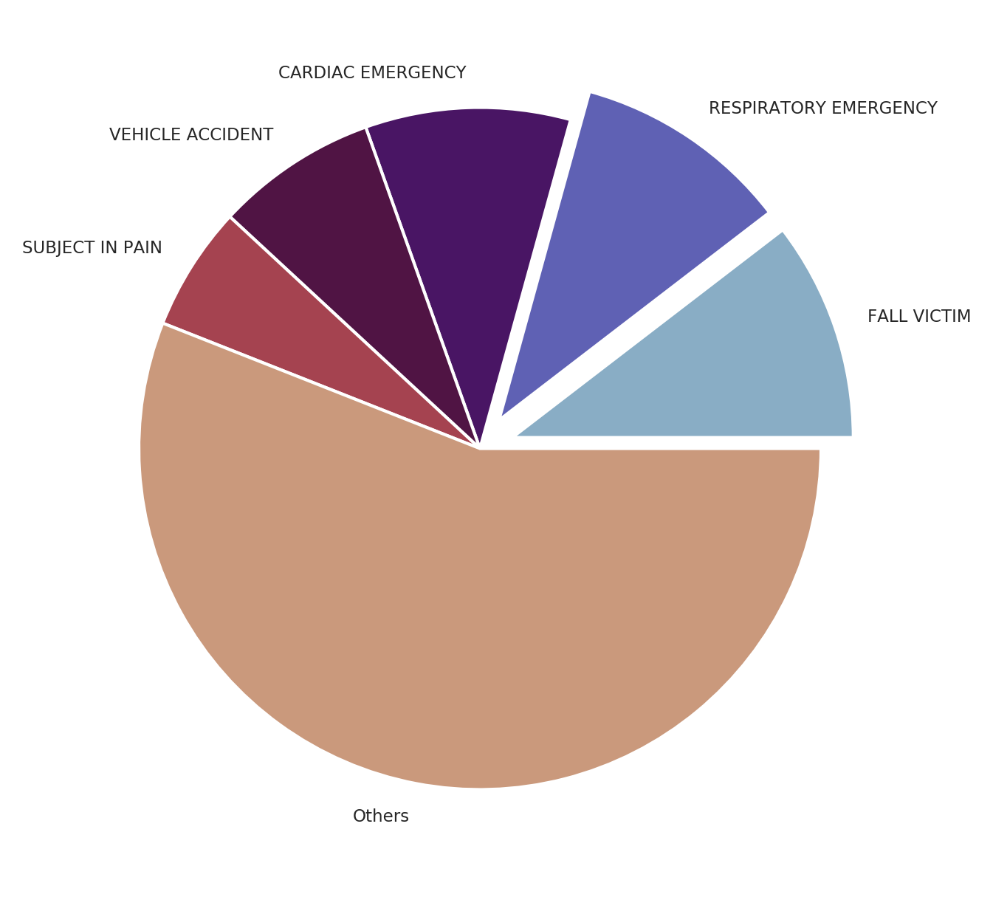
EMS (Emergency Medical Service) - Sub Reasons

Slide 10
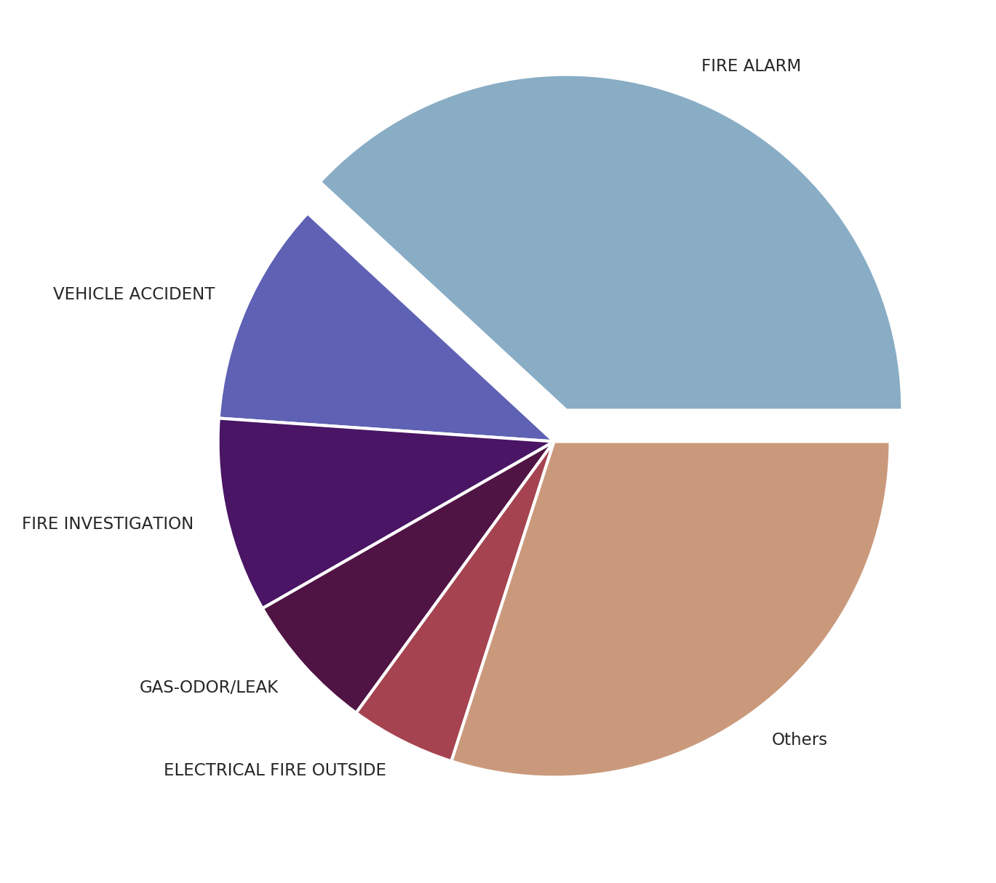
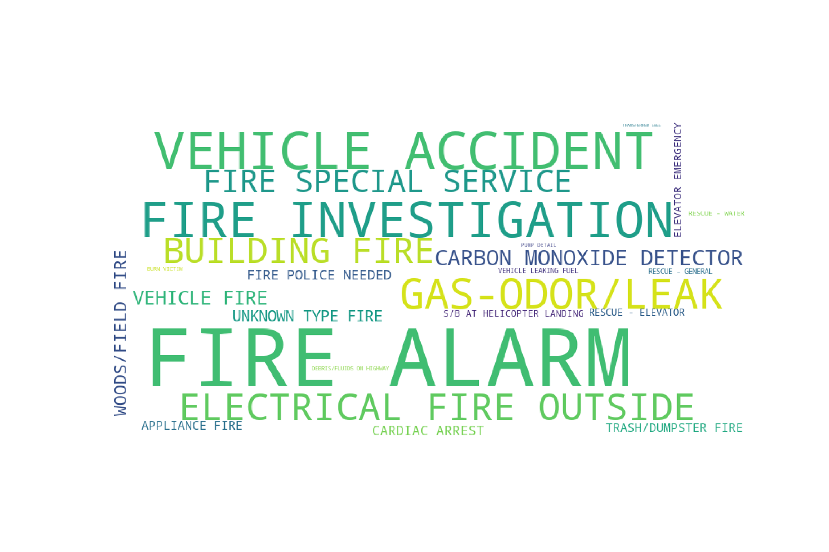
Fire - Sub Reasons

Slide 11
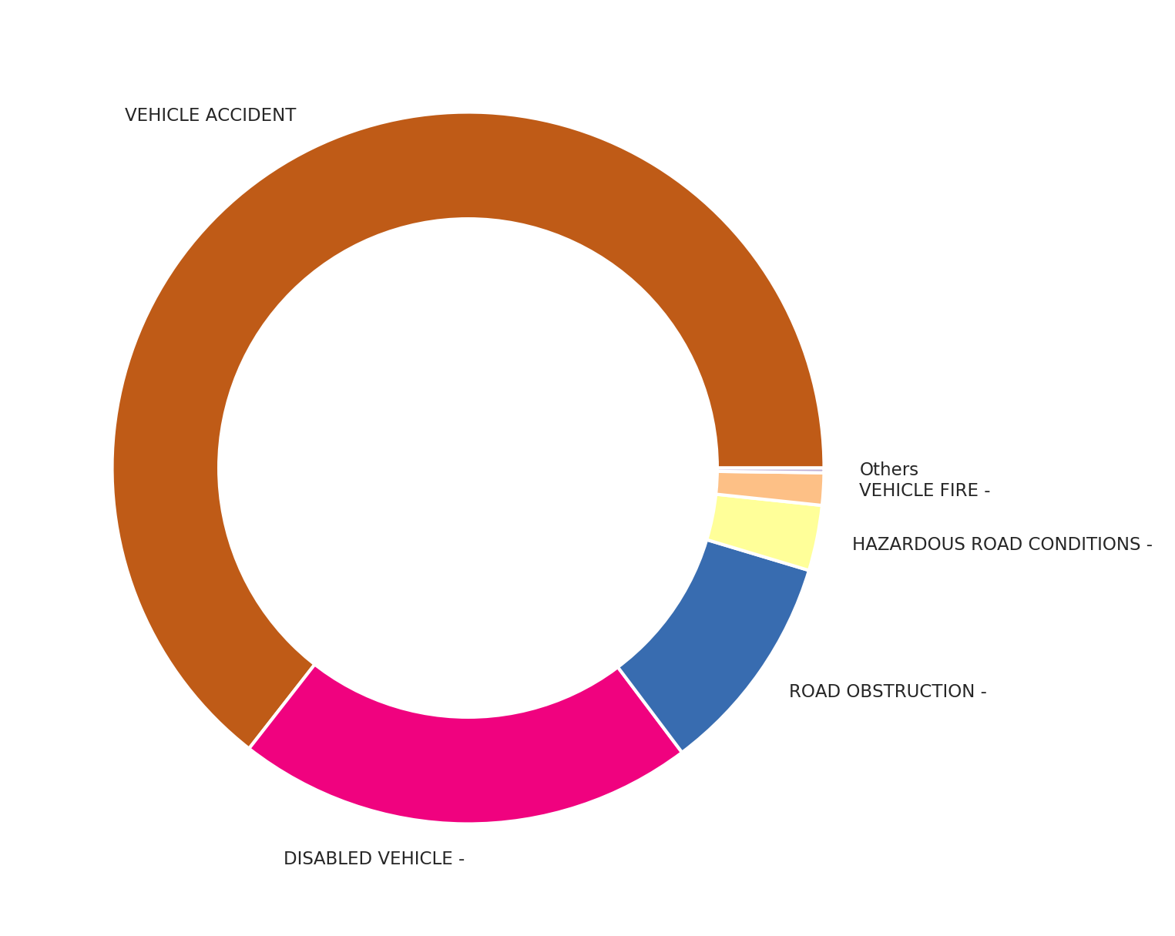

Traffic - Sub Reasons

Slide 12
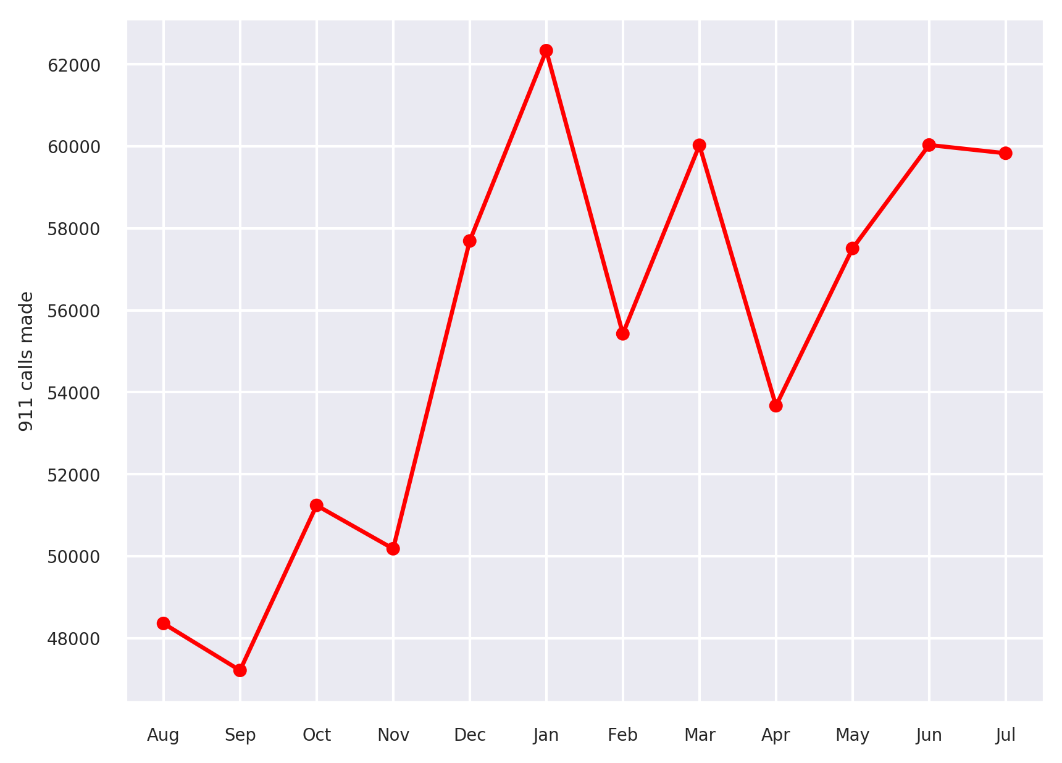
Interesting things to look at
Month with largest calls

Slide 13
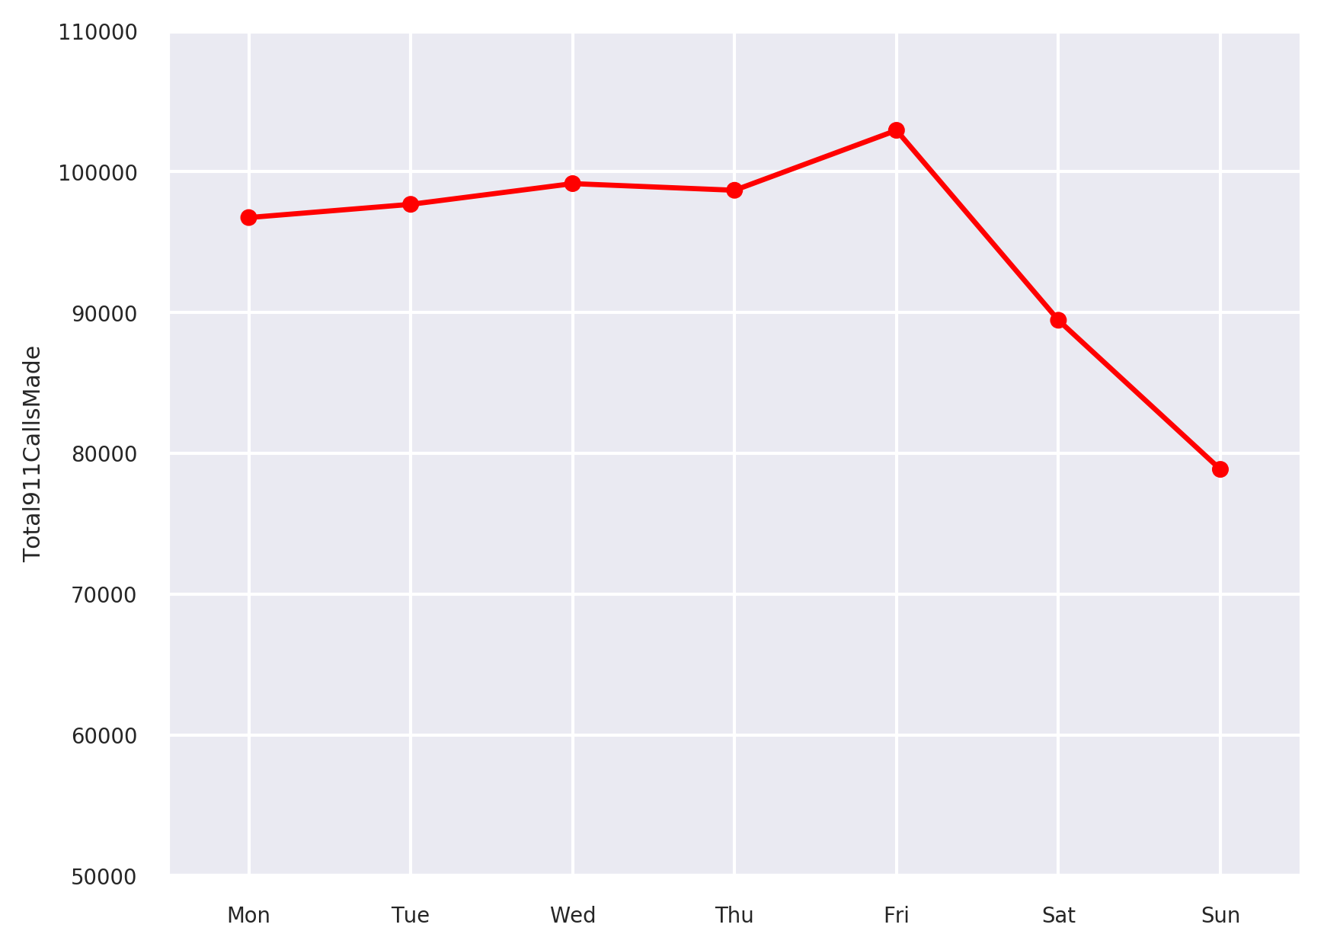
Day with highest calls

Slide 14
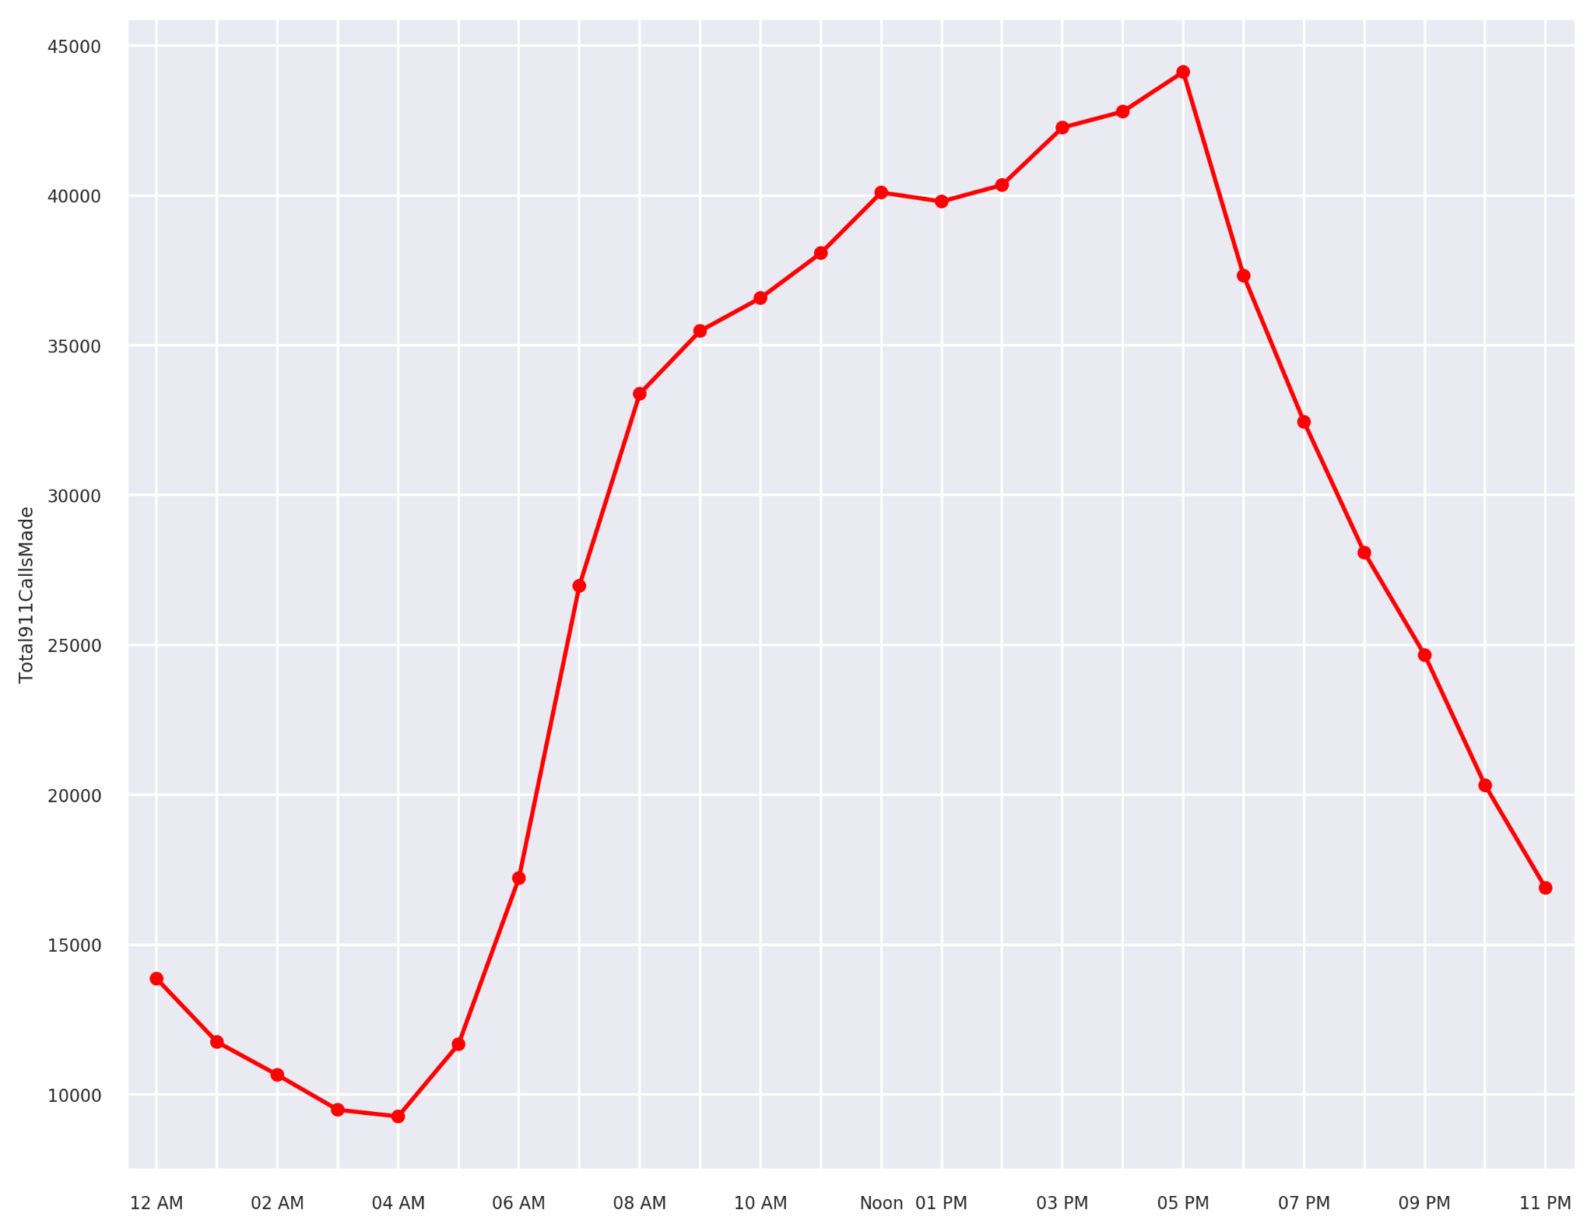
Hour with Highest Calls

Slide 15
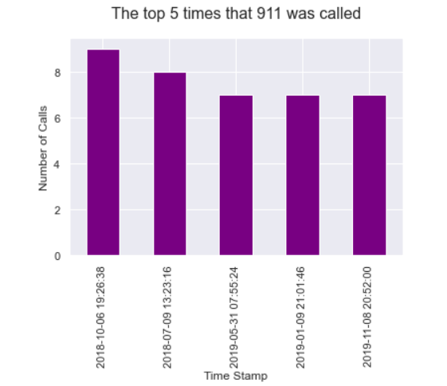
Top 5 times that 911 were called

Slide 16

Acknowledgement
Special thanks to our very dear and handsome Professor Moussa Doumbia for his effort in teaching us Data Science. He is the reason we have the opportunity to present our work and learning in front of the class.

Slide 17
That’s all.
Thank You !!

